Slide 1
Conversational Patterns in a CSCL Environment

Slide 2
Method
First, Second, and Third-Order Patterns
First Order: Frequency of different types of discourse
Second Order: Frequency and patterns in discourse pairs
E.g. “50% of Replies are following by a reply” or “20% of hedges are followed by a hedge”
Third Order: Frequency of patterns in discourse triplets.
Take all second order pairs. E.g. “Hedge->Hedge.” What comes next? Is it another hedge, or is there a pattern to how we exit the cycle.
Find a viable way to visualize these patterns.

Slide 3
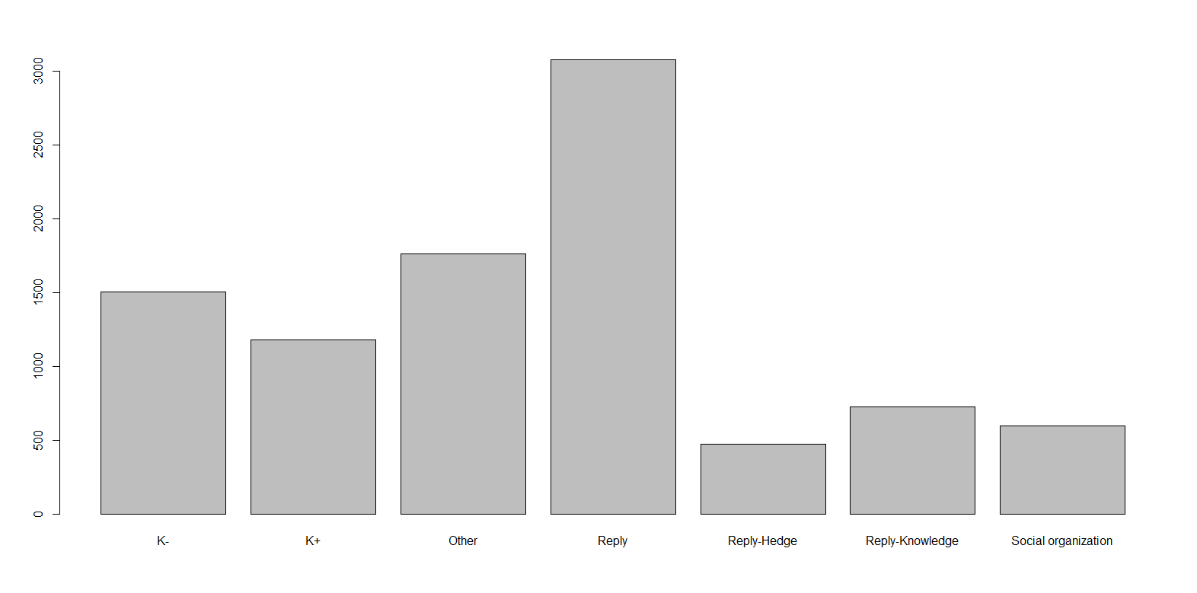
First Order Patterns

Slide 4
Second-Order Patterns
RQ: What simple conversational patterns exist in student discourse?

Slide 5
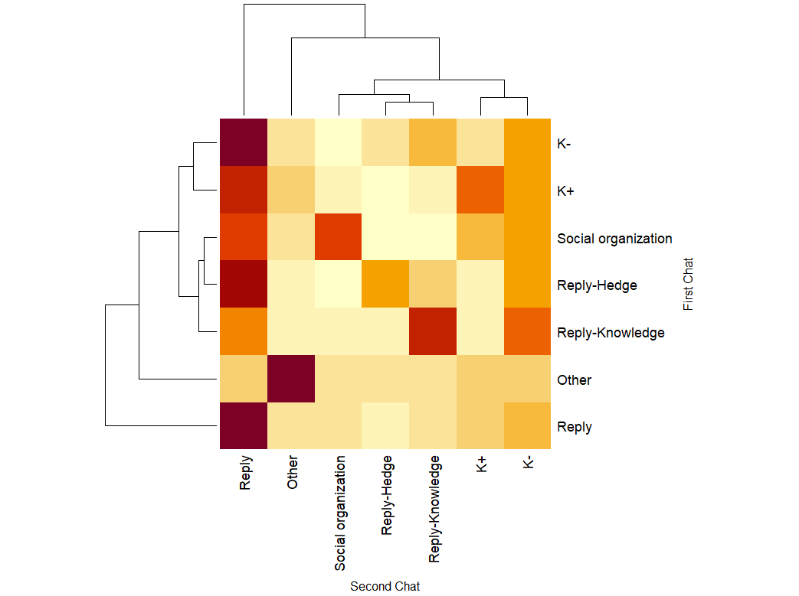
Three Second-Order Patterns

Slide 6
Transitionary Communication

Slide 7
Stacking Communication

Slide 8
“Inviting” Communication

Slide 9
Third-Order Patterns
RQ: What conversational patterns lead to knowledge construction?

Slide 10
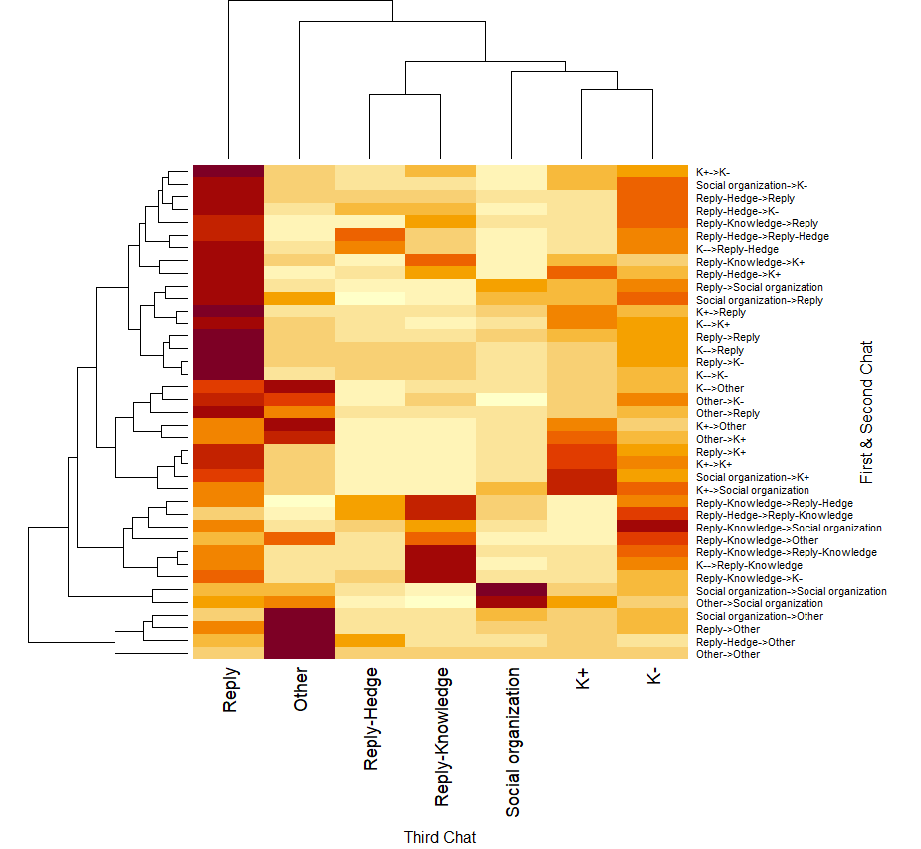

Slide 12
Continued Presence of Transitionary, Stacking, and Invitational Discourse

Slide 13
Three Distinct Paths to Knowledge

Slide 14
Path 1: Novel Knowledge
Attempts to exit reply cycle by suggesting a new path or piece of knowledge.
Accomplished directly through Reply-Knowledge or indirectly through K-

Slide 15
Path 2: Support or Refute
K- almost always present in prior discourse
Modifies or tentatively supports existing knowledge proposition

Slide 16
Path 3: Codification
Where are our K- turned into K+? Appears to be somewhere in the “Reply Monolith” in which ideas are chewed on.
Ideas tend to live here for a long time (A reply is followed by another reply 45% of the time) and it is hard to predict what conversational patterns will follow a reply once the cycle ends.

Slide 17
Path 4: Confirmation
In either direct or indirect response to a K+
“End of the road.” We are no longer building knowledge; we have reached an end point.

Slide 18
Conceptual Model of Idea Generation
Support
Codify
Previous Conversation
Novel Suggestion
Confirm
Refute

